Slide 1
Traffic Management using AI
Ahmed Alaa Mahmoud Gamal
Mohamed Elshafey Rami Shoula
Sara Elbesomy

Slide 2
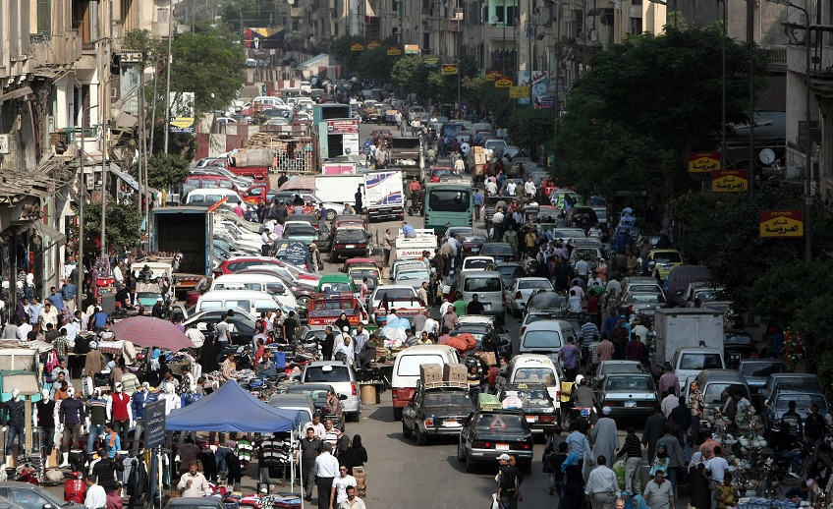
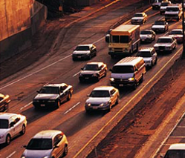
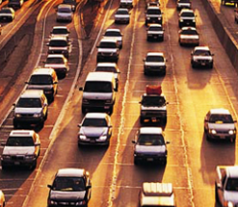
ABOUT US
We are a team of 5 with technical background in NanoTechnology, electronics, communication and Information technology.
Our goal is to apply our knowledge into a social impact solutions to help our community.

Slide 3
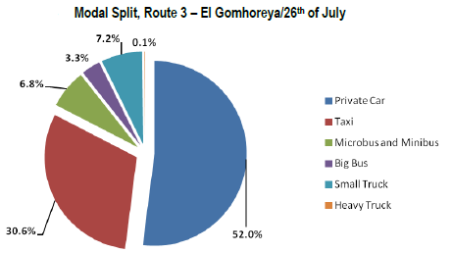
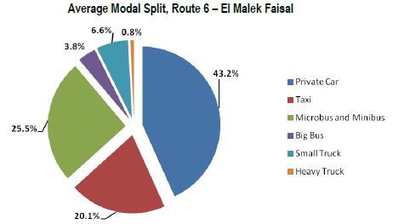
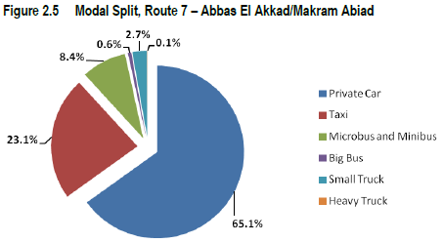
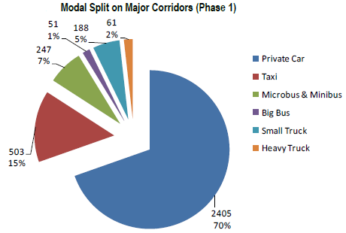
Motivation - Cairo Main roads traffic
Source: Cairo Cost of Congestion Phase 1 Study.

Slide 4
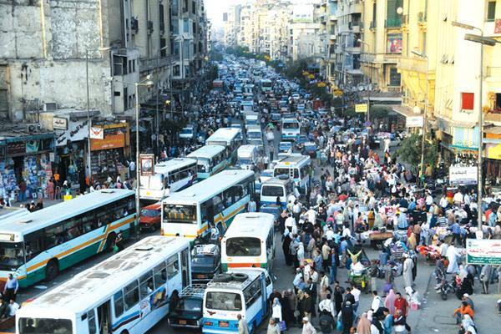
Idea
Our idea is to implement a more effective traffic system in highly dense regions in Egypt as our traffic system has many issues that yields huge problems affect all society such:
Accidents because of the higher chances of collisions.
Delays and wasting time for passengers so, it has a very negative impact on the economy.
Negative impact on the vehicles health.
Wasted fuel and air pollution increasing due to emissions of CO₂

Slide 5
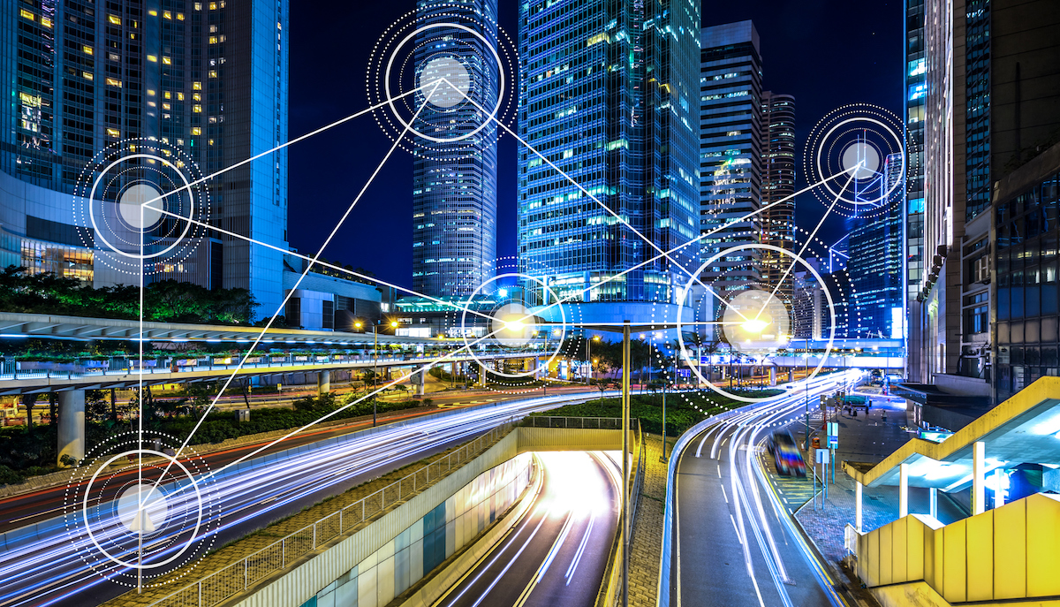
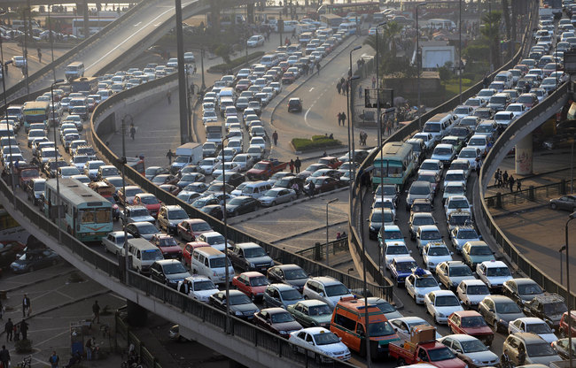
SOLUTION
These mentioned problems caused by various reasons , one of them is the inefficient use of the existing network.
We propose to use AI algorithms to solve this problem:
We would like to use AI to make our traffic light to learn what is the best option to take. By using RL , for example, we give the traffic light agent the opportunity to learn online while make its predictions which make him smarter every single time step.
In addition , we need to make a compatible IOT structure for the city to boost the performance of the traffic management agents.

Slide 6




4 Focuses Approach
Our solution have a positive social impact as it relieves the traffic jam on a scale of cities. Therefore:
It save the time of passengers.
It prevent many health problems in the community.
Social
Discuss the impact of the start-up on 4 different levels that define the goals of AT.
Economic
Improve the good’s transportation quality and make it faster.
Reduce the fuel usage so, it helps individuals save its costs.
Technical
Our solution aim to use very high technology as it will use AI algorithms in addition to IOT solutions to make the traffic system reach the best performance.
It is feasible.
It does not require high computational power to operate.
It could be done be local technology providers.
Environmental
Reduce the harmful emissions rates.
Reduce the usage of fuel.
Reduce wastes by reducing crashes

Slide 7
SWOT
Strengths
Increase safety and comfort.
Smoothens the traffic flow which decrease the traffic waiting time.
Increase the efficiency of the roads infrastructure.
Decrease fuel consumption.
Decrease pollution.
Increase the dependency on autonomous vehicles which is a international demand.
Opportunities
V2V/V2I communication is a trending field that may assist the traffic management to be more reliable.
Improving the infrastructure by using one smart algorithm that increase the efficiency of your existing infrastructure.
Development of smart cities is a global direction.
Funder and Investors in such business.
Weaknesses
Needs high maintenance.
Needs high quality components.
High initial costs.
May cause limits over speed , so it may decrease the network efficiency.
Unpredictable actions from the autonomous vehicles or traffic lights that may cause disasters.
Increase the overall time travel for passengers by putting restrictions over speed.
Car companies may threaten our product because we will decrease their production.
Threats

Slide 8
Refined SWOT Matrix
 | Strengths: | Weaknesses:
Marketing Factors | Various marketing schemes (pamflet, advertising. etc.) readily available at low cost | No recognition of Non-Motorised Transport (NMT) policy
Financial Factors | High demand for public transport | Large area, large population and rapid growth are difficult to manage
Operation Factors | Capability to carry high volumes | Weak enforcement of traffic laws
Organizational Factors | Suitable for long distance transport | Lack of organizational capacity to cover entire region
 | Opportunities: | Threats:
Micro Environment Forces | Large Population Robust economy Attractive for investment strategic location as an economic hub (great economic potential) | Insufficient (transport) infrastructure Weak technology and innovation Risk of climate change Unpredictable weather conditions

Slide 9
Business Plan
 | Strengths: | Weaknesses:
Opportunities: | SO Strategies Utilizing rising economy and large populus to enforce traffic regulations Implement long distance routes such as highways with less exits Apply services along routes as a secondary income source | WO Strategies Enforce strict laws and regulations for transportation routes Employ official NMT routes and raise awareness Implement subway/train routes to regulate dense population
Threats: | ST Strategies Invest in transportation technologies Promote events to increase awareness of public safety and transport regulations | WT Strategies Using subway/train system to reduce weather climate effects Employ rapid traffic regulations for crash incidents Regularly enhance and update transport infrastructure with latest technologies

Slide 10
Action Roadmap
Short Term (1-5)
Long Term (5-10)
1.
2.
3.
4.
Basic Features
More Features
National Expansion
International Expansion
In this stage we just launching the most basic features which are the accurate traffic map for Egypt and apply our model on a small city
In this stage we expand our features to include accidents prediction to decrease the traffic congestions due them.
In this stage we will seek to apply our system in many other cities to cover all of Egypt.
In this stage we will try to modify our system to be applicable in other countries based on the probabilities of each country

Slide 11
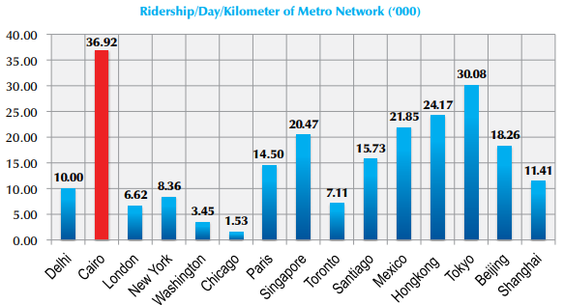
Market Size - METRO RIDERSHIP AND DEMAND IN CAIRO AND OTHER MAJOR CITIES
The Greater Cairo Metropolitan Area (GCMA), with more than 19 million inhabitants, is host to more than one-fifth of Egypt’s population. Expected to further increase to 24 million by 2027.
Source: Cairo Cost of Congestion Phase 1 Study.

Slide 12
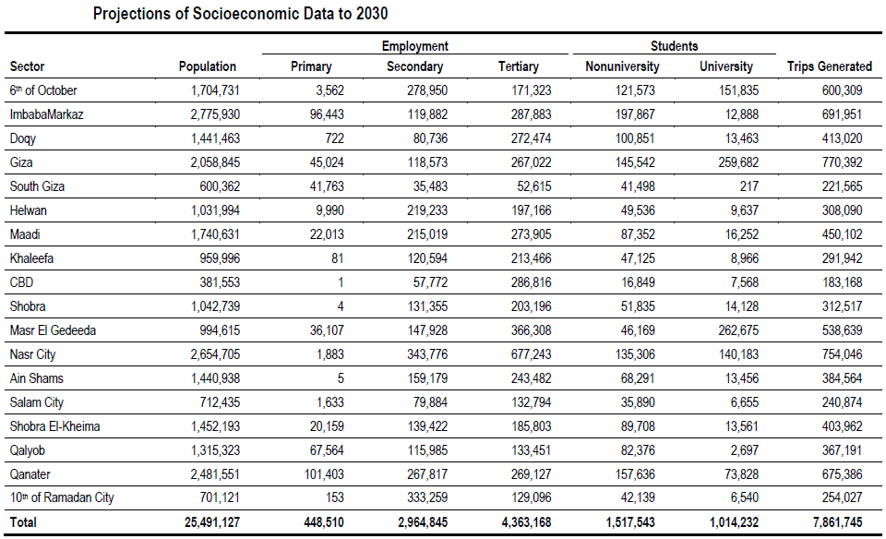
Market size - Population
Source: The World Bank Group.

Slide 13
Market Size - Cost
Around 2 million dollars per km for a standard 11 meter wide, two lane asphalt paved road, including regular drainage. Bridges have to be considered individually,
Egypt has about 1.01 Million Kilometer squard.
So, The estimated market size = 24.2 Million dollars.

Slide 14
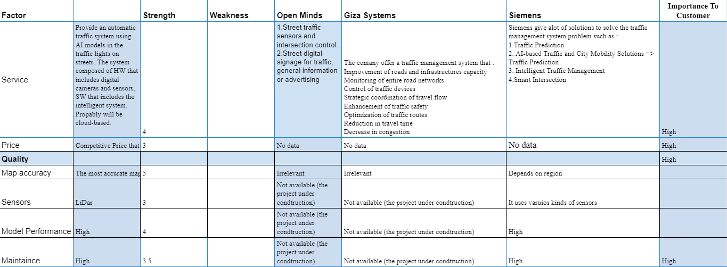
Competitive Analysis

Slide 15
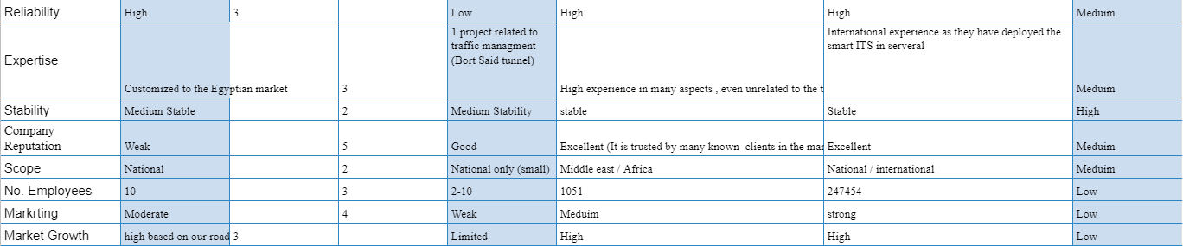
Competitive Analysis

Slide 16

Reference
Comcec.org. 2015. Evaluation of Urban Transport in OIC Megacities – Review of the Case Studies. [online] Available at: <http://www.comcec.org/wp-content/uploads/2015/11/Shields-Achmadi-2.pdf> [Accessed 12 April 2021].
Ir.egytrans.com. 2010. http://ir.egytrans.com/pdf/CI%20Capital%20Research.pdf. [online] Available at: <http://ir.egytrans.com/pdf/CI%20Capital%20Research.pdf> [Accessed 12 April 2021].
https://openknowledge.worldbank.org/bitstream/handle/10986/18734/ACS93620ESW0wh0Combined0Outpu0Final.pdf?sequence=1&isAllowed=y

Slide 17
THANK YOU!

Slide 18
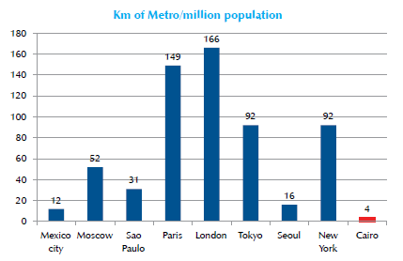
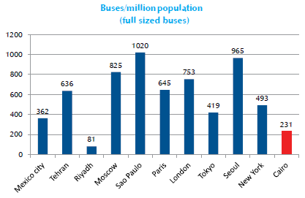
Market Size Comparison - International
METRO AND BUS SUPPLY IN CAIRO AND OTHER MAJOR CITIES IN THE WORLD
Source: Cairo Cost of Congestion Phase 1 Study.

